Slide 1
Structural Optimisation Using Statistical Inference Techniques
Zoe Tan
Notes:
the aims of the project and their significance;
the background and context;
your plan of how to achieve the aims;
the progress made so far towards fulfilling the plans.

Slide 2
Structural Optimisation
Structural optimization can be seen as a (constrained) multi-variate minimisation of a “black-box” function
Behaviour of a structure can be modelled using Finite Element Models
Imperfect models (and prototypes) mean data is noisy
Take noisy data points, estimate overall distribution and find the minimum point

Slide 3
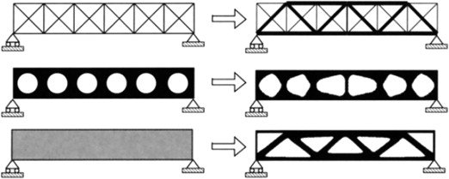
Notes:
Scope of project limited to parameter optimisation, which can include all 3 types seen here but the problems would need to be parameterised.
size optimisation easy to see, make variables the radius of each beam in the truss
shape optimisation more difficult, can define continuous variables e.g. lengths and angles of polygons or discrete variables e.g. a finite selection of shapes (star, rectangle, oval etc.)
Topology optimisation (material layout within predefined space) even more difficult to parameterise, no predefined configuration but can probably be done (thickness of each finite element)

Slide 4
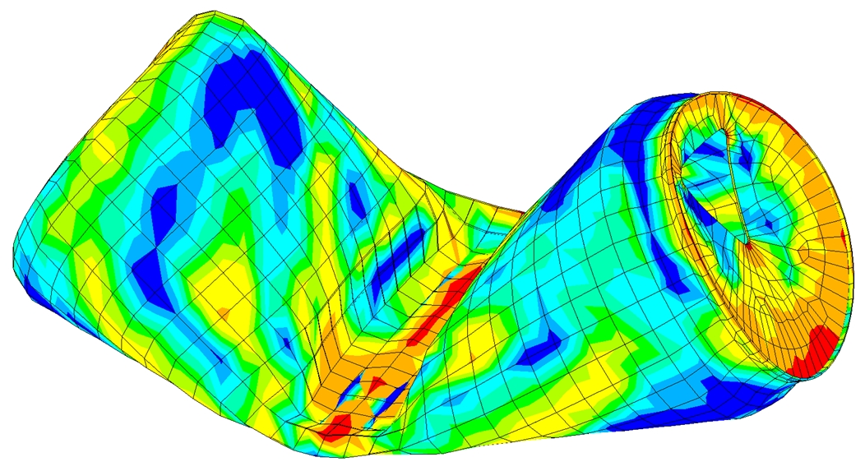
Notes:
Finite element model example

Slide 5
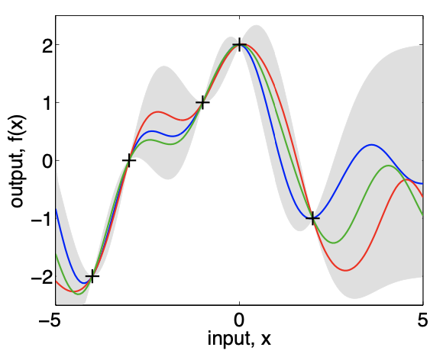
Gaussian Processes
Multivariate Gaussian distribution with infinitely many variables – models functions
Defined by a mean function and a covariance function
Bayesian – p(y|x)=p(x|y)p(y)/p(x)
Can incorporate acquisition functions to efficiently find new data points of interest
Notes:
Basic explanation of Gaussian Process – like a gaussian distribution but for functions
Mean function pretty self explanatory
Covariance function defines covariance between points some distance apart – how form of function and characteristics like wiggiliness
Acquisition function balances exploration and exploitation

Slide 6
Optimising the Optimisation
Difficulties
Solutions
Gaussian Process posterior (and predictive distribution) has a term which requires calculating [K(x,x)+σ_{noise} I]⁻¹
O(N³) to calculate inverse of a matrix
Optimising with respect to many parameters and dealing with large datasets
Sparse GP
Summarise large dataset with a smaller number of pseudo-data
Can optimise for where these pseudo-data are to get best approximate posterior distribution
Reduce complexity to O(N²M)
Multi-fidelity GP
Notes:
Posterior of the Gaussian process

Slide 7
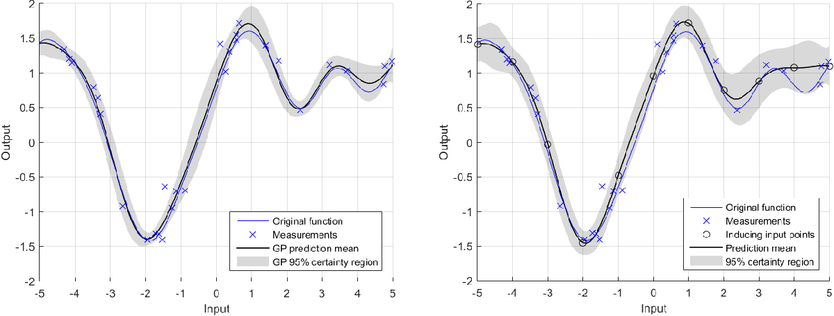

Slide 8
Plan
Explore basic Bayesian Optimisation using Gaussian Process models
Progressed
Coded in Python using GPyOpt library basic functionality and low and high dimensional functions with known optimums
Find bottlenecks in the optimisation process and explore how these can be reduced
Progressing – using Python GPy library for sparseGP support
Explore FEM code – build some basic models (cantilever beam, bridge, etc.)
Apply GP model optimisation on structural problems
Stretch goals – investigate other forms of statistical inference that can be applied to structural optimisation
Notes:
Aim: explore how Bayesian optimisation can be applied on structural optimisation problems using Gaussian Process models trained on FEM data.
Some conclusions so far – non-convex functions get much bigger errors (but this is to be expected, more local minima to get stuck in)
Sparse GP good for when initially given lots of data points but not for using acquisition function to get more points – probably estimations stacking

